Slide 1

End-to-End Chain: From Patient Visit to Insurance Reimbursement
This presentation will outline the detailed step-by-step process in a healthcare system, from the patient’s initial visit to the doctor, to how the Medical Code RAG Model enhances accuracy in medical coding, claims, and reimbursement.
SK

Slide 2
1️⃣ Patient Visit & Initial Interaction
Patient Arrival
Role of the Medical Assistant
The patient arrives at the clinic or hospital with a complaint (e.g., chest pain). The receptionist or medical assistant collects basic information (e.g., personal details, insurance info).
The medical assistant records the patient’s vital signs (e.g., blood pressure, heart rate, temperature). They document the chief complaint and initial symptoms in the medical records system.

Slide 3
2️⃣ Doctor's Assessment & Diagnosis
Physician's Role
Doctor’s Clinical Documentation
The doctor reviews the patient’s history and physical condition. They conduct an examination (e.g., checks vital signs, runs lab tests, performs physical assessments). They make a diagnosis (e.g., suspected heart attack - Myocardial Infarction).
The History & Physical (H&P) form is filled out. The diagnosis (e.g., Myocardial Infarction) is noted with the appropriate ICD-10 code (e.g., I21.9). The treatment plan is documented, which may include procedures, medications, and follow-ups.

Slide 4
3️⃣ Medical Procedure & Treatment
Treatment Implementation
Medical Documentation by Nurses & Surgeons
The nurse administers prescribed treatments (e.g., aspirin, nitroglycerin). The surgical team (if applicable) conducts any medical procedures (e.g., angioplasty or cardiac catheterization).
Nursing notes track medication administration, vital signs, and changes in condition. Surgical notes are recorded if surgery is performed, including details of the procedure, tools used, and outcomes. Procedure codes (e.g., CPT 93454 for coronary angiography) are assigned by coders.

Slide 5

4️⃣ Medical Coding
1
Coders convert clinical documentation (doctor’s notes, surgery records, and diagnostic test results) into ICD-10, CPT, and HCPCS codes.
2
ICD-10: Diagnoses (e.g., Type 2 Diabetes → E11.9). CPT: Medical procedures (e.g., office visit → 99213). HCPCS: Drugs and treatments (e.g., Metformin → J8499).
3
The Medical Code RAG Model aids coders by automatically suggesting accurate medical codes based on the clinical documentation.
4
The RAG model uses real-time retrieval of medical guidelines, payer policies, and historical claims data to suggest the best possible codes.

Slide 6
5️⃣ Claims Submission & Review
Medical Biller's Role
Claim Validation (RAG Model)
The medical biller reviews the assigned codes, ensuring they are correct and aligned with payer policies (e.g., Medicare, private insurance). The biller submits the claim to the insurance provider using the correct codes.
The RAG model cross-checks codes with payer policies to ensure they meet guidelines (e.g., CPT 99213 is valid for a regular office visit with established patients). It flags invalid codes, incorrect billing, or potential fraud (e.g., if a service is billed without sufficient documentation). Real-time claim validation reduces rejections due to incorrect or mismatched codes.

Slide 7
6️⃣ Insurance Review & Reimbursement
Insurance Provider’s Role
RAG Model’s Contribution
The insurance company reviews the claim against its policy (e.g., coverage for certain procedures or medications). The insurance provider checks the codes for accuracy, and if everything aligns, approves the claim for reimbursement.
The RAG model ensures the codes are aligned with current medical guidelines and insurance policies. In case of denied claims, the model assists in appeal generation, suggesting historical cases where similar claims were approved. This helps billers justify denied claims.

Slide 8

7️⃣ Claim Approval, Denial, or Appeal
Approved Claims
Denied Claims
Appeals
The insurance provider processes and reimburses the healthcare provider for the services rendered.
If the claim is rejected due to errors, the medical coder or biller can use the RAG model to analyze and correct the mistake, preparing a more accurate claim submission.
If a claim is denied, the RAG model helps billers justify the appeal by referencing historical case data and insurance policy documents.

Slide 9
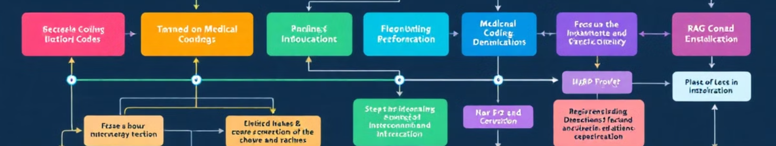
How the Medical Code RAG Model Solves This Chain
1
Automates Medical Code Suggestions: It reads doctor’s notes and suggests the correct ICD, CPT, and HCPCS codes.
2
Real-Time Claim Validation: The model cross-references codes with payer policies and regulations to prevent rejected claims.
3
Error Detection & Fraud Prevention: It flags duplicate codes or non-compliant claims, minimizing errors.
4
Appeal Assistance: In case of denied claims, it helps billers build an appeal based on historical case outcomes.

Slide 10
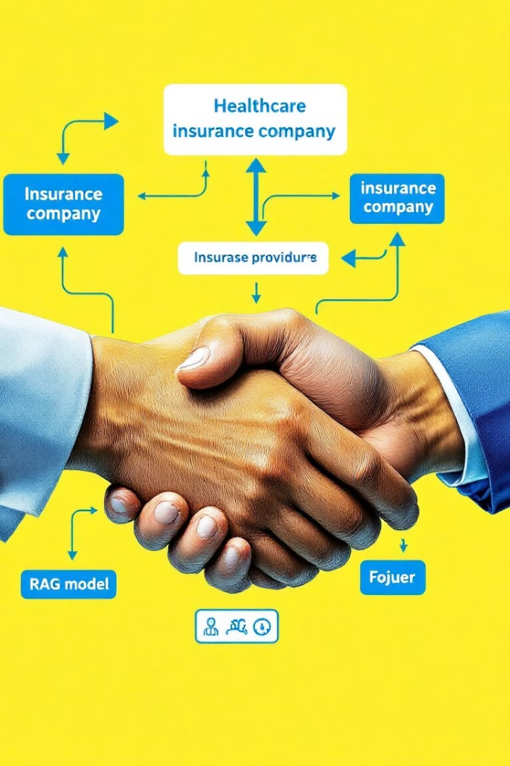
Final Thought
This end-to-end chain integrates medical coding with AI-powered solutions (like the RAG model) to automate the coding process, ensure accuracy, reduce claim rejections, and speed up the overall healthcare reimbursement cycle. 🚀

